Slide 1
BIEN 401 Biomedical Mass Transport Class 10 Boundary Layers and Mass Transfer
notes prepared by
Dr. Louis Reis
Created on 3/27/2022

Slide 2
Fluid Boundary Layer
Recall what happens when we have high velocity flow past an immersed object
A boundary layer forms separating the uniform flow from the flow whose velocity has changed because of the object
Boundary Layer

Slide 3
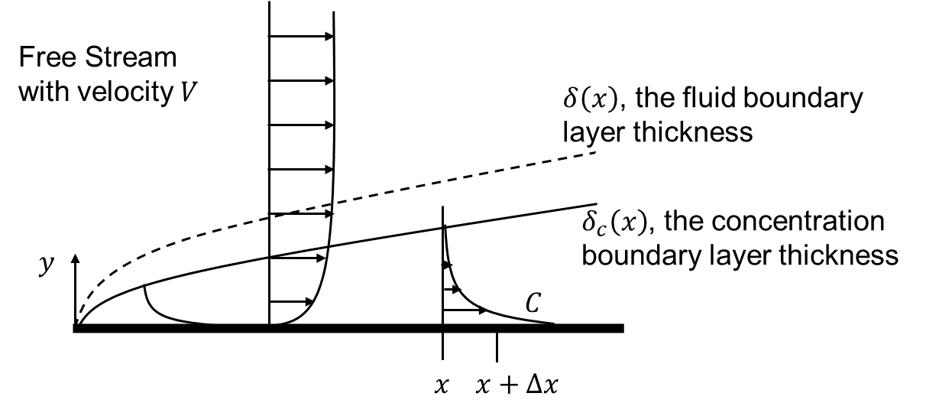
Fluid Boundary Layer
We can determine the fluid boundary layer thickness using Navier-Stokes and momentum balances. Once the fluid boundary layer thickness is determined, we can then determine the concentration boundary layer thickness.
Note that the concentration at the wall is large and as we move away the higher velocity fluid sweeps more of the solute away faster.
At some point far away, the concentration is approximately zero, and so is the flux (in the y-direction).

Slide 4
Approximate Solution
These types of problems can be very difficult to get an exact analysis.
We will try to approximate the solution.
We already have an approximate solution for the fluid boundary layer using the Blasius solution:
Our approximate solution will still need to satisfy the following:
Satisfies a mass balance within a region under the boundary layer
Satisfies boundary conditions at the plate and boundary layer edge
Be based on some perception as to what the profile should look like
Your text book uses 4.64 instead of 5. Many other books might use 5 as it easier to work with. Remember these are approximations anyways.

Slide 5





Assumptions
We will assume that the fluid boundary layer is known (this is very normal even when doing computer modeling; the fluid flow field is determined first, then the mass transport physics can be determined next).
We will assume that the concentration profile can be modeled as a polynomial that decreases as y increases until it reaches 0 at the edge of the boundary layer.
We will assume the form of the concentration profile does not change with x, but the boundary layer thickness will change with x.
$$δ\left(x\right) \left(\text{known}\right)$$
$$δ_{c}\left(x\right)$$
$$y$$
$$C\left(x,y\right)=\text{Polynomial} \text{in} y/δ_{c}\left(x\right)$$
$$x x+Δx$$

Slide 6
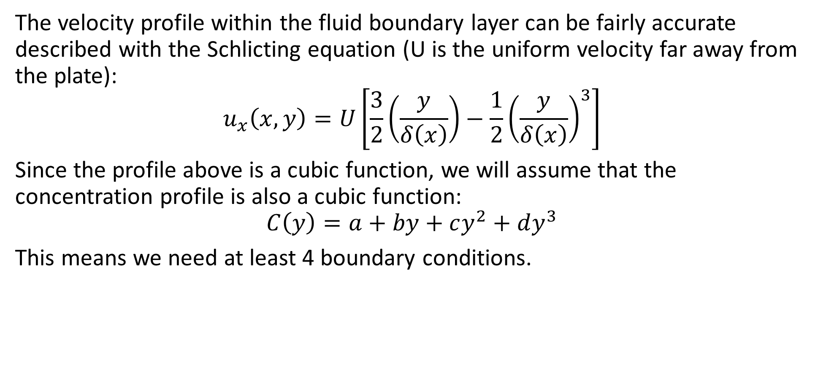
Approximate Profiles
The velocity profile within the fluid boundary layer can be fairly accurate described with the Schlicting equation (U is the uniform velocity far away from the plate):
$$u_{x}\left(x,y\right)=U\left[\frac{3}{2}\left(\frac{y}{δ\left(x\right)}\right)−\frac{1}{2}{\left(\frac{y}{δ\left(x\right)}\right)}^{3}\right]$$
Since the profile above is a cubic function, we will assume that the concentration profile is also a cubic function:
$$C\left(y\right)=a+by+cy^{2}+dy^{3}$$
This means we need at least 4 boundary conditions.
$$δ\left(x\right) \left(\text{known}\right)$$
$$δ_{c}\left(x\right)$$
$$y$$
$$C\left(x,y\right)=\text{Polynomial} \text{in} y/δ_{c}\left(x\right)$$
$$x x+Δx$$

Slide 7
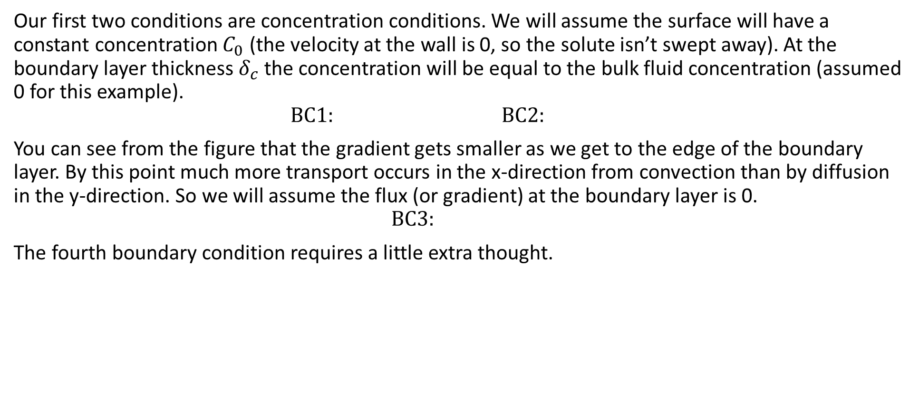
Boundary Conditions
Our first two conditions are concentration conditions. We will assume the surface will have a constant concentration $C_{0}$ (the velocity at the wall is 0, so the solute isn’t swept away). At the boundary layer thickness $δ_{c}$ the concentration will be equal to the bulk fluid concentration (assumed 0 for this example).
$$\text{BC}\text{1}: \text{BC}\text{2}:$$
You can see from the figure that the gradient gets smaller as we get to the edge of the boundary layer. By this point much more transport occurs in the x-direction from convection than by diffusion in the y-direction. So we will assume the flux (or gradient) at the boundary layer is 0.
$$\text{BC}\text{3}:$$
The fourth boundary condition requires a little extra thought.
$$δ\left(x\right) \left(\text{known}\right)$$
$$δ_{c}\left(x\right)$$
$$y$$
$$C\left(x,y\right)=\text{Polynomial} \text{in} y/δ_{c}\left(x\right)$$
$$x x+Δx$$

Slide 8
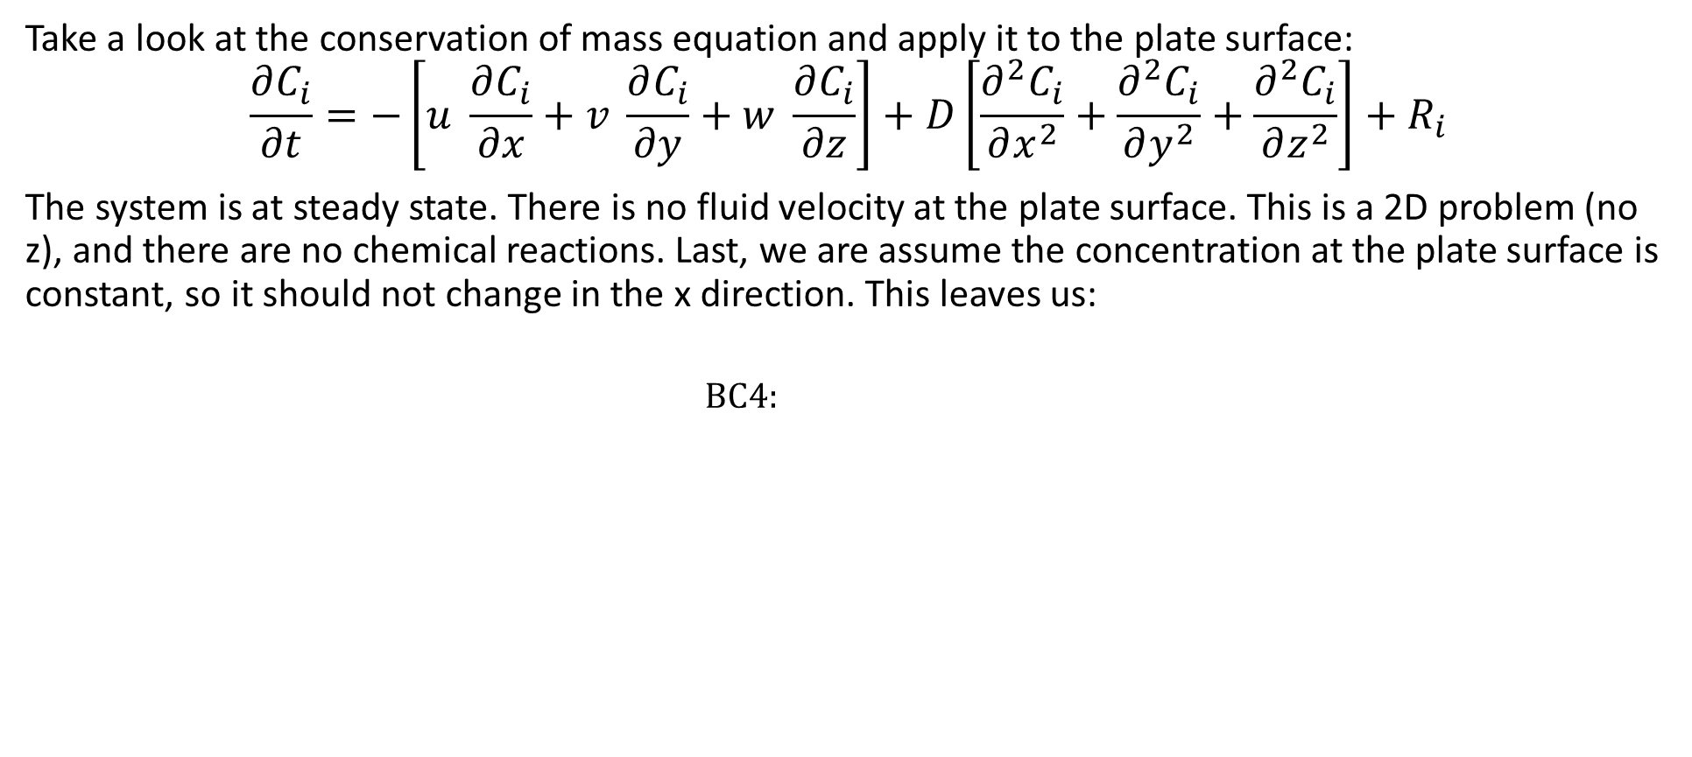
Boundary Conditions
Take a look at the conservation of mass equation and apply it to the plate surface:
$$\frac{∂C_{i}}{∂t}=−\left[u \frac{∂C_{i}}{∂x}+v \frac{∂C_{i}}{∂y}+w \frac{∂C_{i}}{∂z}\right]+D\left[\frac{∂^{2}C_{i}}{∂x^{2}}+\frac{∂^{2}C_{i}}{∂y^{2}}+\frac{∂^{2}C_{i}}{∂z^{2}}\right]+R_{i}$$
The system is at steady state. There is no fluid velocity at the plate surface. This is a 2D problem (no z), and there are no chemical reactions. Last, we are assume the concentration at the plate surface is constant, so it should not change in the x direction. This leaves us:
$$\text{BC}\text{4}:$$
$$δ\left(x\right) \left(\text{known}\right)$$
$$δ_{c}\left(x\right)$$
$$y$$
$$C\left(x,y\right)=\text{Polynomial} \text{in} y/δ_{c}\left(x\right)$$
$$x x+Δx$$

Slide 9

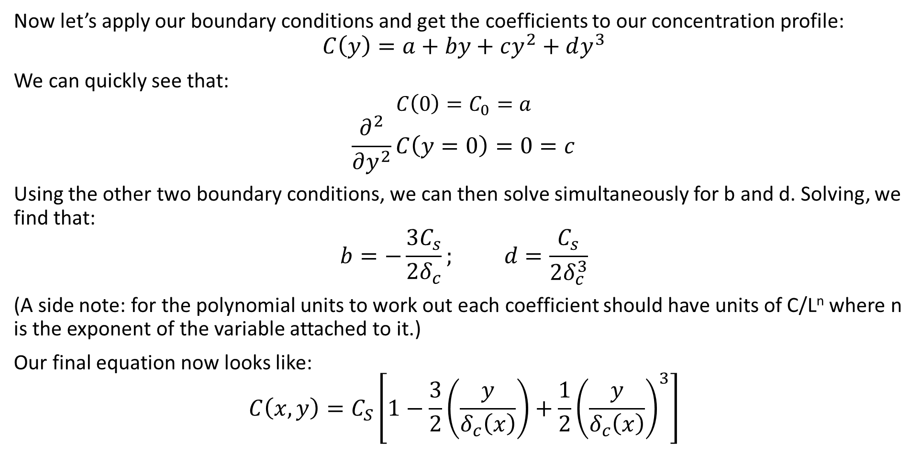
Concentration Profile
Now let’s apply our boundary conditions and get the coefficients to our concentration profile:
$$C\left(y\right)=a+by+cy^{2}+dy^{3}$$
We can quickly see that:
$$C\left(0\right)=C_{0}=a$$
$$\frac{∂^{2}}{∂y^{2}}C\left(y=0\right)=0=c$$
Using the other two boundary conditions, we can then solve simultaneously for b and d. Solving, we find that:
$$b=−\frac{3C_{s}}{2δ_{c}}; d=\frac{C_{s}}{2δ_{c}^{3}}$$
(A side note: for the polynomial units to work out each coefficient should have units of C/L^{n} where n is the exponent of the variable attached to it.)
Our final equation now looks like:
$$C\left(x,y\right)=C_{S}\left[1−\frac{3}{2}\left(\frac{y}{δ_{c}\left(x\right)}\right)+\frac{1}{2}{\left(\frac{y}{δ_{c}\left(x\right)}\right)}^{3}\right]$$
$$\text{BC}\text{1}:C\left(y=0\right)=C_{0}$$
$$\text{BC}\text{2}:C\left(y=δ_{c}\right)=0$$
$$\text{BC}\text{3}:\frac{∂}{∂y}C\left(y=δ_{c}\right)=0$$
$$\text{BC}\text{4}: \frac{∂^{2}}{∂y^{2}}C\left(y=0\right)=0$$

Slide 10
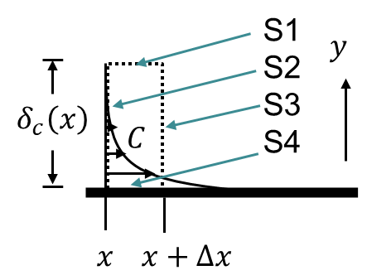
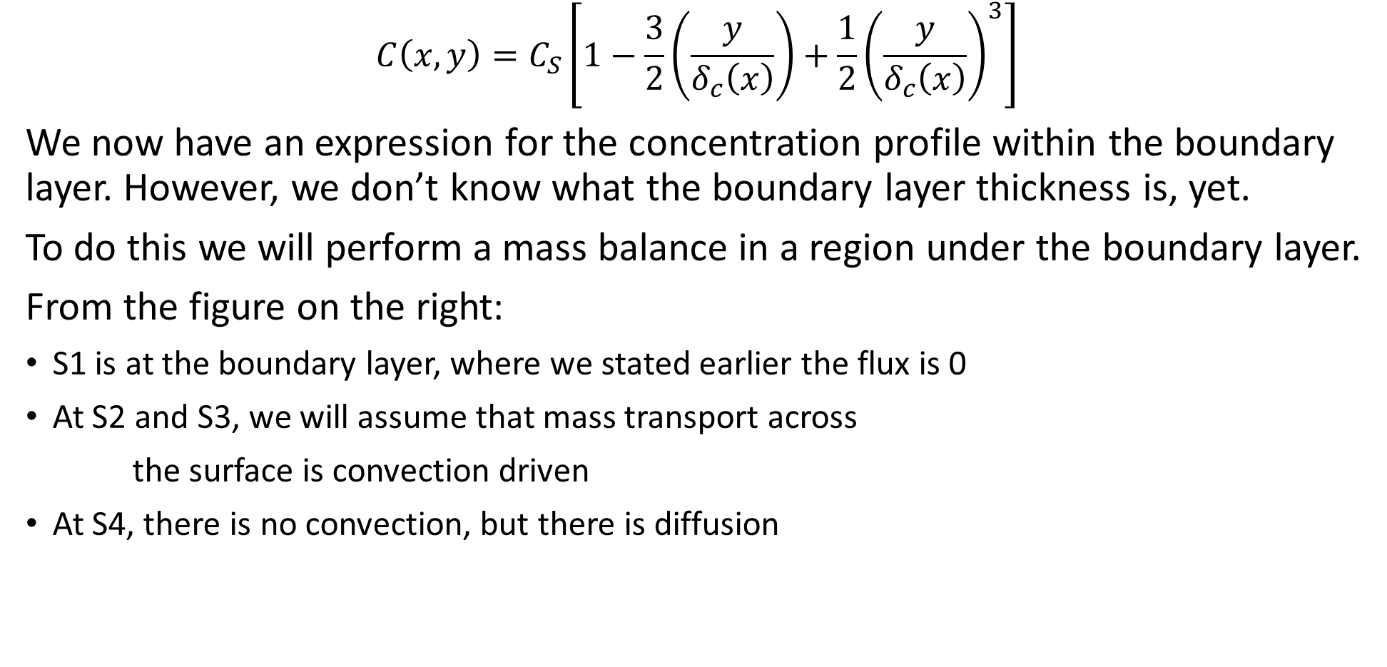
Boundary Layer
$$C\left(x,y\right)=C_{S}\left[1−\frac{3}{2}\left(\frac{y}{δ_{c}\left(x\right)}\right)+\frac{1}{2}{\left(\frac{y}{δ_{c}\left(x\right)}\right)}^{3}\right]$$
We now have an expression for the concentration profile within the boundary layer. However, we don’t know what the boundary layer thickness is, yet.
To do this we will perform a mass balance in a region under the boundary layer.
From the figure on the right:
S1 is at the boundary layer, where we stated earlier the flux is 0
At S2 and S3, we will assume that mass transport across
the surface is convection driven
At S4, there is no convection, but there is diffusion

Slide 11
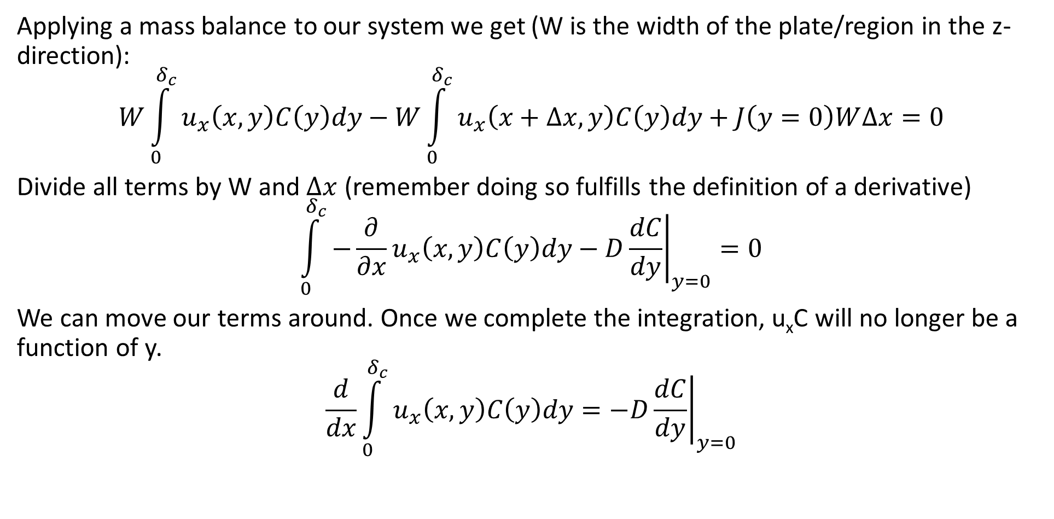
Mass Balance
Applying a mass balance to our system we get (W is the width of the plate/region in the z-direction):
$$W\int_{0}^{δ_{c}}{u_{x}\left(x,y\right)C\left(y\right)dy}−W\int_{0}^{δ_{c}}{u_{x}\left(x+∆x,y\right)C\left(y\right)dy}+J\left(y=0\right)W∆x=0$$
Divide all terms by W and $∆x$ (remember doing so fulfills the definition of a derivative)
$$\int_{0}^{δ_{c}}{−\frac{∂}{∂x}u_{x}\left(x,y\right)C\left(y\right)dy}−D{\left.\frac{dC}{dy}\right|}_{y=0}=0$$
We can move our terms around. Once we complete the integration, u_{x}C will no longer be a function of y.
$$\frac{d}{dx}\int_{0}^{δ_{c}}{u_{x}\left(x,y\right)C\left(y\right)dy}=−D{\left.\frac{dC}{dy}\right|}_{y=0}$$

Slide 12
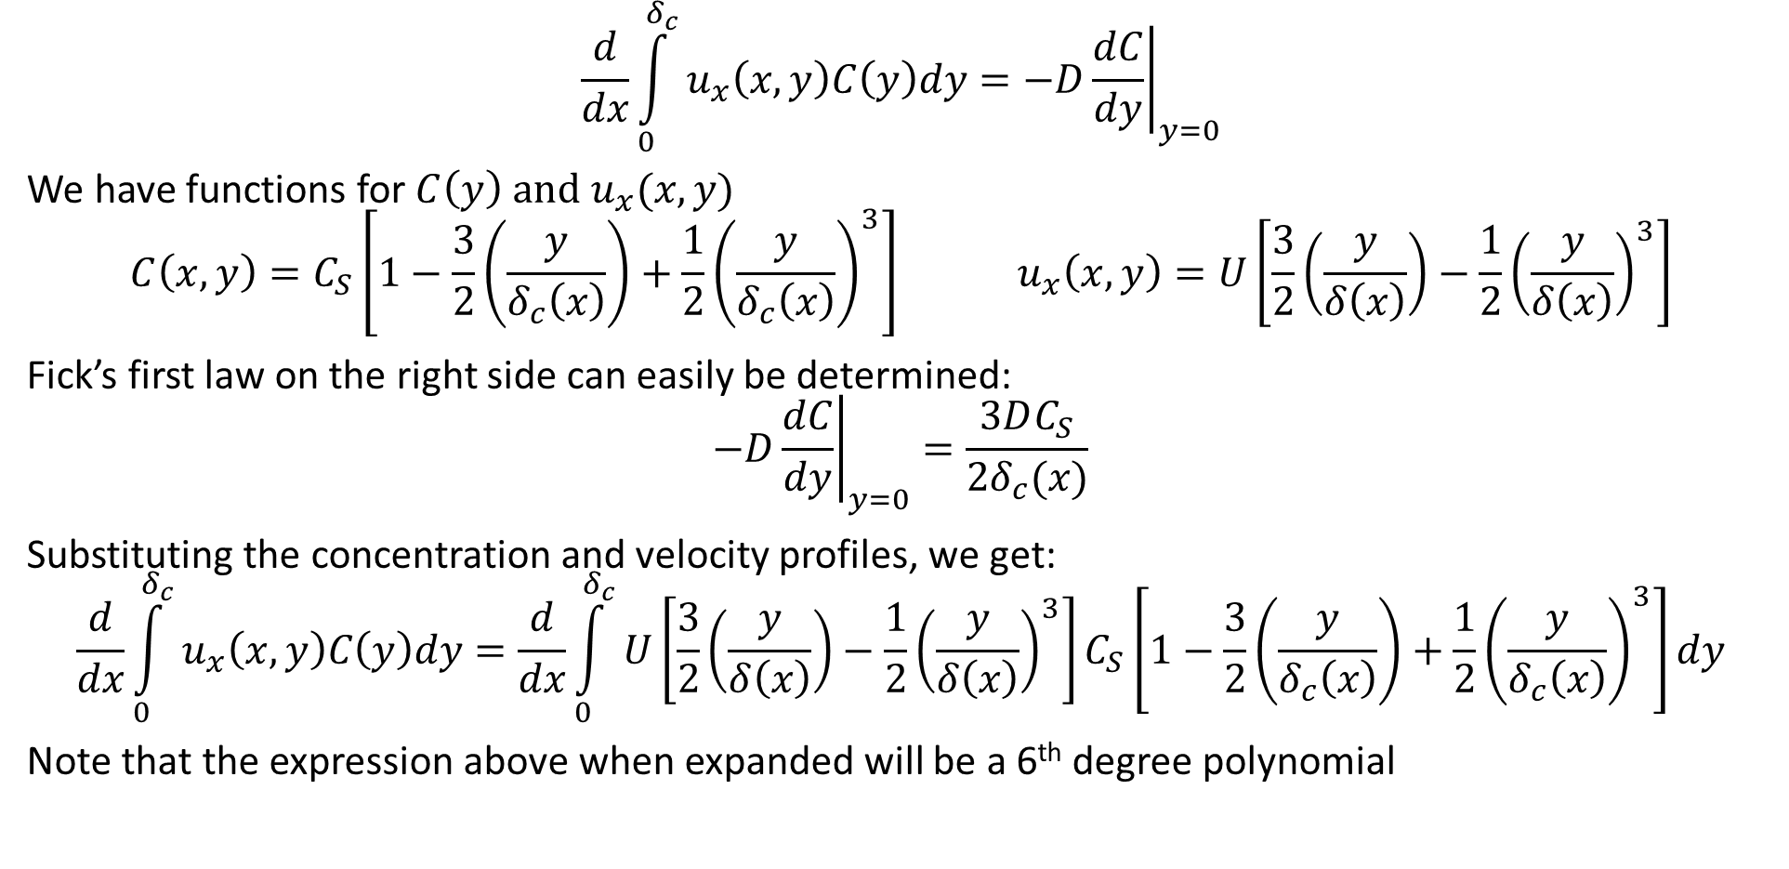
Mass Balance
$$\frac{d}{dx}\int_{0}^{δ_{c}}{u_{x}\left(x,y\right)C\left(y\right)dy}=−D{\left.\frac{dC}{dy}\right|}_{y=0}$$
We have functions for $C\left(y\right) \text{and} u_{x}(x,y)$
$$C\left(x,y\right)=C_{S}\left[1−\frac{3}{2}\left(\frac{y}{δ_{c}\left(x\right)}\right)+\frac{1}{2}{\left(\frac{y}{δ_{c}\left(x\right)}\right)}^{3}\right] u_{x}\left(x,y\right)=U\left[\frac{3}{2}\left(\frac{y}{δ\left(x\right)}\right)−\frac{1}{2}{\left(\frac{y}{δ\left(x\right)}\right)}^{3}\right]$$
Fick’s first law on the right side can easily be determined:
$$−D{\left.\frac{dC}{dy}\right|}_{y=0}=\frac{3DC_{S}}{2δ_{c}(x)}$$
Substituting the concentration and velocity profiles, we get:
$$\frac{d}{dx}\int_{0}^{δ_{c}}{u_{x}\left(x,y\right)C\left(y\right)dy}=\frac{d}{dx}\int_{0}^{δ_{c}}{U\left[\frac{3}{2}\left(\frac{y}{δ\left(x\right)}\right)−\frac{1}{2}{\left(\frac{y}{δ\left(x\right)}\right)}^{3}\right]C_{S}\left[1−\frac{3}{2}\left(\frac{y}{δ_{c}\left(x\right)}\right)+\frac{1}{2}{\left(\frac{y}{δ_{c}\left(x\right)}\right)}^{3}\right]dy}$$
Note that the expression above when expanded will be a 6th degree polynomial

Slide 13
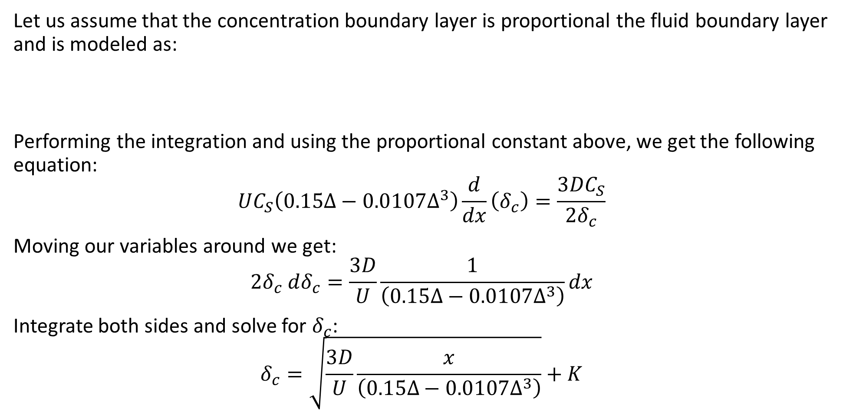
Boundary Layer
Let us assume that the concentration boundary layer is proportional the fluid boundary layer and is modeled as:
Performing the integration and using the proportional constant above, we get the following equation:
$$UC_{S}\left(0.15∆−0.0107∆^{3}\right)\frac{d}{dx}\left(δ_{c}\right)=\frac{3DC_{S}}{2δ_{c}}$$
Moving our variables around we get:
$$2δ_{c} dδ_{c}=\frac{3D}{U}\frac{1}{\left(0.15∆−0.0107∆^{3}\right)}dx$$
Integrate both sides and solve for $δ_{c}$:
$$δ_{c}=\sqrt{\frac{3D}{U}\frac{x}{\left(0.15∆−0.0107∆^{3}\right)}}+K$$

Slide 14
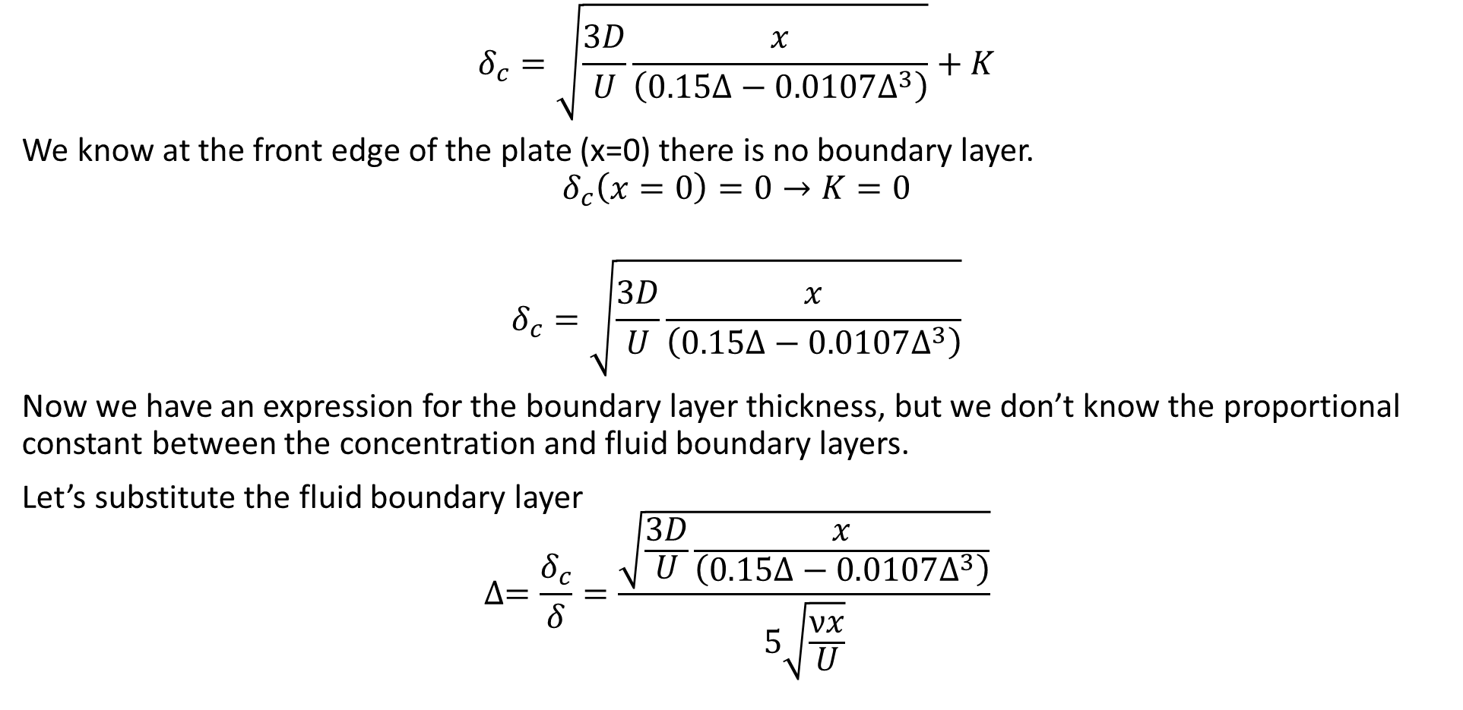
Concentration Boundary Layer
$$δ_{c}=\sqrt{\frac{3D}{U}\frac{x}{\left(0.15∆−0.0107∆^{3}\right)}}+K$$
We know at the front edge of the plate (x=0) there is no boundary layer.
$$δ_{c}\left(x=0\right)=0→K=0$$
$$δ_{c}=\sqrt{\frac{3D}{U}\frac{x}{\left(0.15∆−0.0107∆^{3}\right)}}$$
Now we have an expression for the boundary layer thickness, but we don’t know the proportional constant between the concentration and fluid boundary layers.
Let’s substitute the fluid boundary layer
$$∆=\frac{δ_{c}}{δ}=\frac{\sqrt{\frac{3D}{U}\frac{x}{\left(0.15∆−0.0107∆^{3}\right)}}}{5\sqrt{\frac{νx}{U}}}$$

Slide 15

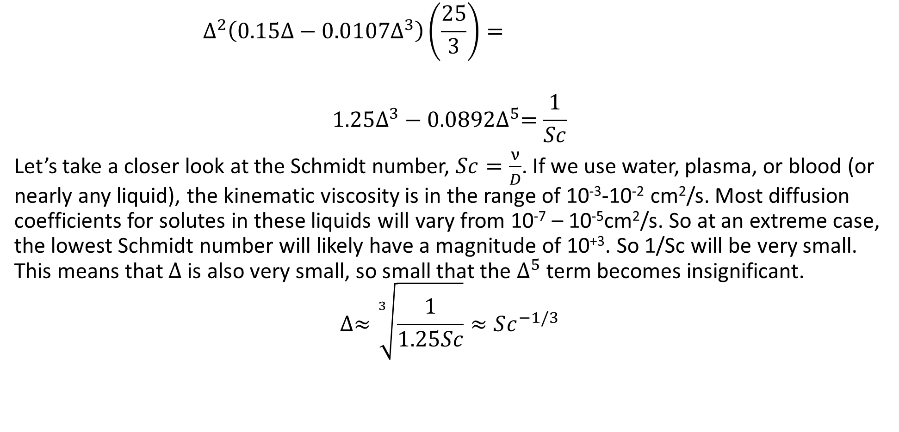
Boundary Layer Proportions
$$∆^{2}\left(0.15∆−0.0107∆^{3}\right)\left(\frac{25}{3}\right)=$$
$$1.25∆^{3}−0.0892∆^{5}=\frac{1}{Sc}$$
Let’s take a closer look at the Schmidt number, $Sc=\frac{ν}{D}$. If we use water, plasma, or blood (or nearly any liquid), the kinematic viscosity is in the range of 10⁻³-10⁻² cm²/s. Most diffusion coefficients for solutes in these liquids will vary from 10⁻⁷ – 10⁻⁵cm²/s. So at an extreme case, the lowest Schmidt number will likely have a magnitude of 10⁺³. So 1/Sc will be very small. This means that $∆$ is also very small, so small that the $∆^{5}$ term becomes insignificant.
$$∆≈\sqrt[3]{\frac{1}{1.25Sc}}≈Sc^{−1/3}$$
Using 4.64 instead of 5, will give you:
$$1.0765∆^{3}−0.0768∆^{5}$$

Slide 16
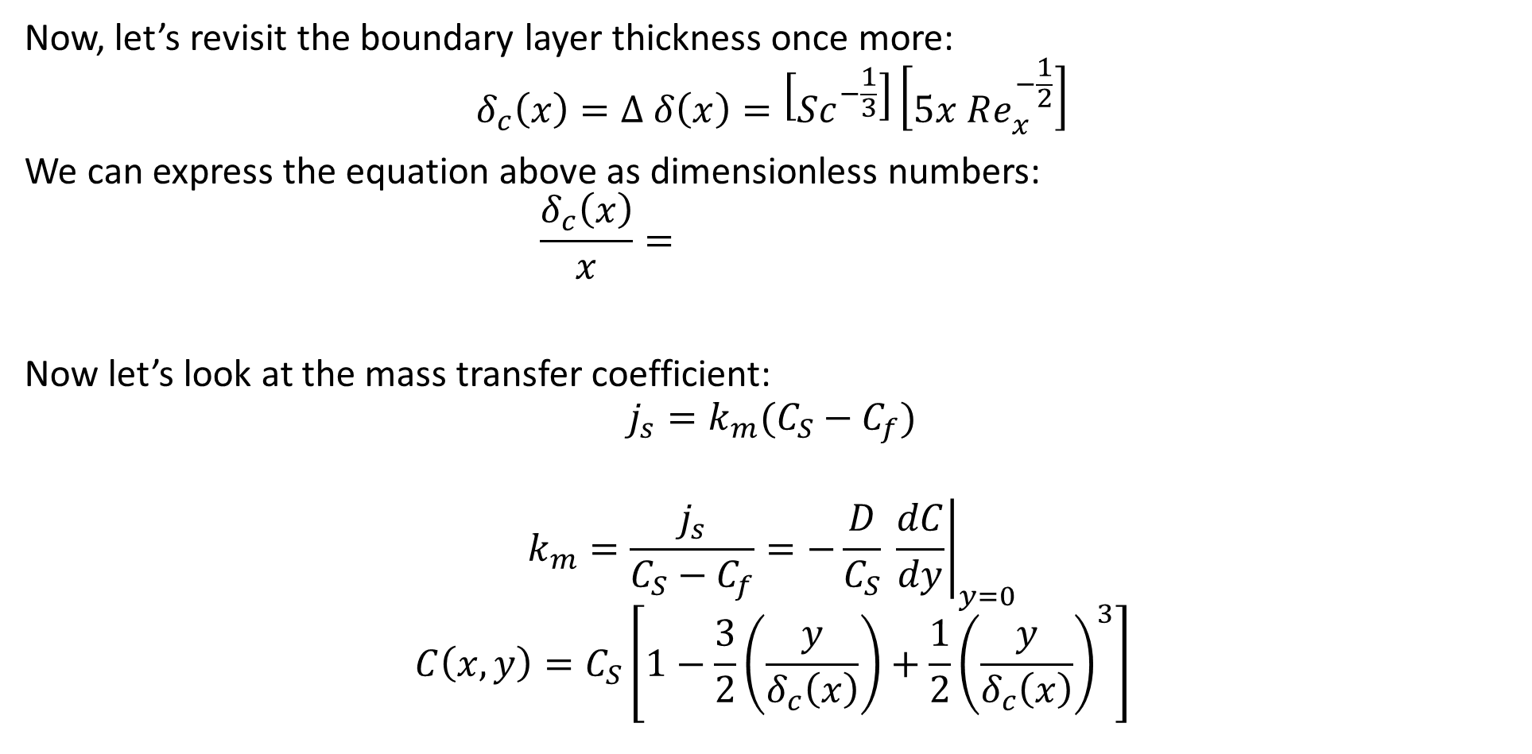
Boundary Layer and Dimensionless Groups
Now, let’s revisit the boundary layer thickness once more:
$$δ_{c}\left(x\right)=∆ δ\left(x\right)=\left[Sc^{−\frac{1}{3}}\right]\left[5x Re_{x}^{−\frac{1}{2}}\right]$$
We can express the equation above as dimensionless numbers:
$$\frac{δ_{c}\left(x\right)}{x}=$$
Now let’s look at the mass transfer coefficient:
$$j_{s}=k_{m}(C_{S}−C_{f})$$
$$k_{m}=\frac{j_{s}}{C_{S}−C_{f}}=−\frac{D}{C_{S}} {\left.\frac{dC}{dy}\right|}_{y=0}$$
$$C\left(x,y\right)=C_{S}\left[1−\frac{3}{2}\left(\frac{y}{δ_{c}\left(x\right)}\right)+\frac{1}{2}{\left(\frac{y}{δ_{c}\left(x\right)}\right)}^{3}\right]$$

Slide 17
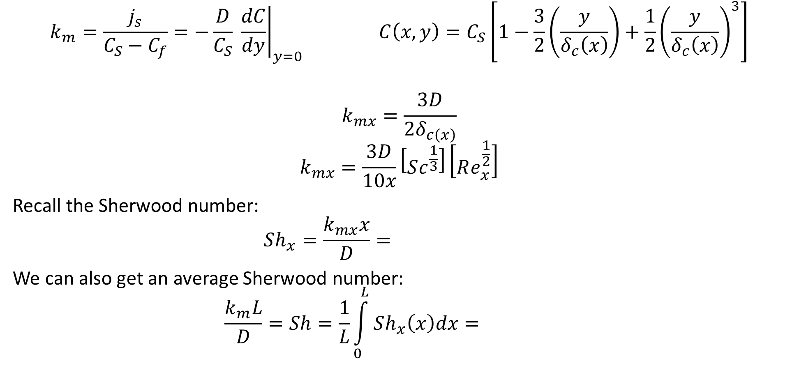
Mass Transfer Coefficient
$$k_{m}=\frac{j_{s}}{C_{S}−C_{f}}=−\frac{D}{C_{S}} {\left.\frac{dC}{dy}\right|}_{y=0} C\left(x,y\right)=C_{S}\left[1−\frac{3}{2}\left(\frac{y}{δ_{c}\left(x\right)}\right)+\frac{1}{2}{\left(\frac{y}{δ_{c}\left(x\right)}\right)}^{3}\right]$$
$$k_{mx}=\frac{3D}{2δ_{c\left(x\right)}}$$
$$k_{mx}=\frac{3D}{10x}\left[Sc^{\frac{1}{3}}\right]\left[Re_{x}^{\frac{1}{2}}\right]$$
Recall the Sherwood number:
$$Sh_{x}=\frac{k_{mx}x}{D}=$$
We can also get an average Sherwood number:
$$\frac{k_{m}L}{D}=Sh=\frac{1}{L}\int_{0}^{L}{Sh_{x}\left(x\right)dx}=$$
Using 4.64 instead of 5, will give you:
0.323 instead 0.3.

Slide 18

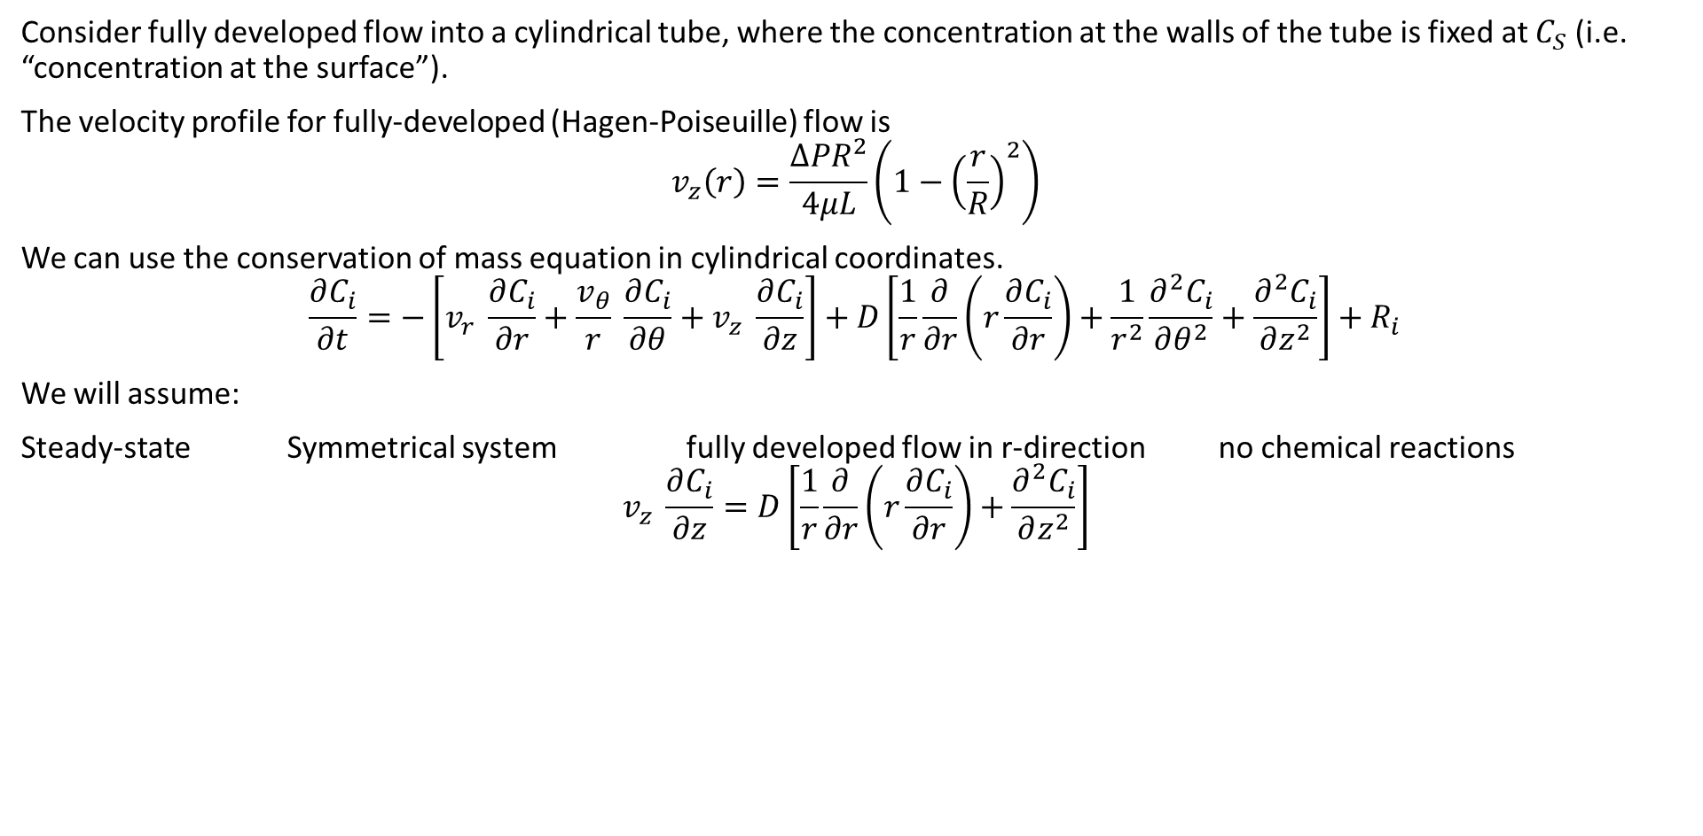


Boundary Layer for Laminar Flow in Cylinder
Consider fully developed flow into a cylindrical tube, where the concentration at the walls of the tube is fixed at $C_{S}$ (i.e. “concentration at the surface”).
The velocity profile for fully-developed (Hagen-Poiseuille) flow is
$$v_{z}\left(r\right)=\frac{{ΔPR}^{2}}{4μL}\left(1−{\left(\frac{r}{R}\right)}^{2}\right)$$
We can use the conservation of mass equation in cylindrical coordinates.
$$\frac{∂C_{i}}{∂t}=−\left[v_{r} \frac{∂C_{i}}{∂r}+\frac{v_{θ}}{r} \frac{∂C_{i}}{∂θ}+v_{z} \frac{∂C_{i}}{∂z}\right]+D\left[\frac{1}{r}\frac{∂}{∂r}\left(r\frac{∂C_{i}}{∂r}\right)+\frac{1}{r^{2}}\frac{∂^{2}C_{i}}{∂θ^{2}}+\frac{∂^{2}C_{i}}{∂z^{2}}\right]+R_{i}$$
We will assume:
Steady-state Symmetrical system fully developed flow in r-direction no chemical reactions
$$v_{z} \frac{∂C_{i}}{∂z}=D\left[\frac{1}{r}\frac{∂}{∂r}\left(r\frac{∂C_{i}}{∂r}\right)+\frac{∂^{2}C_{i}}{∂z^{2}}\right]$$
$$r$$
dr
$$z$$
dz
$$C_{S}$$

Slide 19

Boundary Layer for Laminar Flow in Cylinder
$$v_{z} \frac{∂C_{i}}{∂z}=D\left[\frac{1}{r}\frac{∂}{∂r}\left(r\frac{∂C_{i}}{∂r}\right)+\frac{∂^{2}C_{i}}{∂z^{2}}\right]$$
Typically, transport by convection is much larger than transport by diffusion.
$$v_{z} \frac{∂C_{i}}{∂z}=D\frac{1}{r}\frac{∂}{∂r}\left(r\frac{∂C_{i}}{∂r}\right)$$
$$\frac{{ΔPR}^{2}}{4μL}\left(1−{\left(\frac{r}{R}\right)}^{2}\right)\frac{∂C_{i}}{∂z}=D\frac{1}{r}\frac{∂}{∂r}\left(r\frac{∂C_{i}}{∂r}\right)$$
$$r$$
dr
$$z$$
dz
$$C_{S}$$

Slide 20
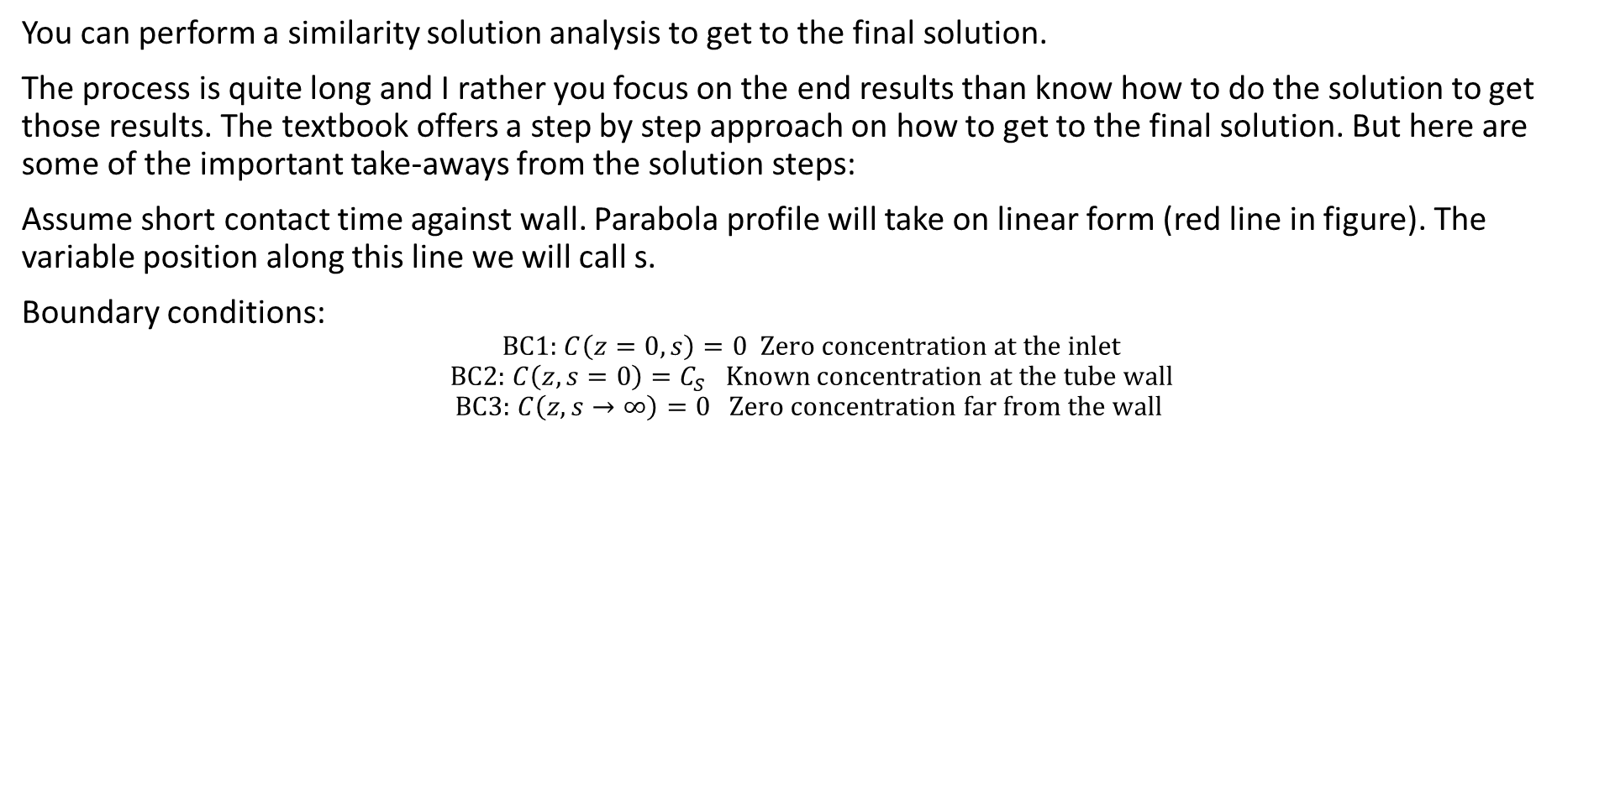
Solution
You can perform a similarity solution analysis to get to the final solution.
The process is quite long and I rather you focus on the end results than know how to do the solution to get those results. The textbook offers a step by step approach on how to get to the final solution. But here are some of the important take-aways from the solution steps:
Assume short contact time against wall. Parabola profile will take on linear form (red line in figure). The variable position along this line we will call s.
Boundary conditions:
$$\text{BC}\text{1: }C\left(z=0,s\right)=0 \text{Zero} \text{concentration} \text{at} \text{the} \text{inlet}$$
$$\text{BC}\text{2:} C\left(z,s=0\right)=C_{S} \text{Known} \text{concentration} \text{at} \text{the} \text{tube} \text{wall}$$
$$\text{BC}\text{3:} C\left(z, s→∞\right)=0 \text{Zero} \text{concentration} \text{far} \text{from} \text{the} \text{wall}$$
$$r$$
dr
$$z$$
dz
$$C_{S}$$

Slide 21
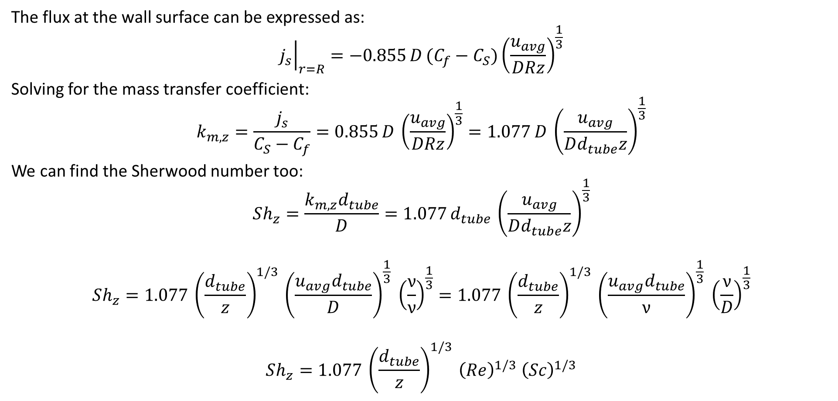
Mass Transfer Coefficient
The flux at the wall surface can be expressed as:
$${\left.j_{s}\right|}_{r=R}=−0.855 D (C_{f}−C_{S}){\left(\frac{u_{avg}}{DRz}\right)}^{\frac{1}{3}}$$
Solving for the mass transfer coefficient:
$$k_{m,z}=\frac{j_{s}}{C_{S}−C_{f}}=0.855 D {\left(\frac{u_{avg}}{DRz}\right)}^{\frac{1}{3}}=1.077 D {\left(\frac{u_{avg}}{Dd_{tube}z}\right)}^{\frac{1}{3}}$$
We can find the Sherwood number too:
$$Sh_{z}=\frac{k_{m,z}d_{tube}}{D}=1.077 d_{tube} {\left(\frac{u_{avg}}{Dd_{tube}z}\right)}^{\frac{1}{3}}$$
$$Sh_{z}=1.077 {\left(\frac{d_{tube}}{z}\right)}^{1/3} {\left(\frac{u_{avg}d_{tube}}{D}\right)}^{\frac{1}{3}} {\left(\frac{ν}{ν}\right)}^{\frac{1}{3}}=1.077 {\left(\frac{d_{tube}}{z}\right)}^{1/3} {\left(\frac{u_{avg}d_{tube}}{ν}\right)}^{\frac{1}{3}} {\left(\frac{ν}{D}\right)}^{\frac{1}{3}}$$
$$Sh_{z}=1.077 {\left(\frac{d_{tube}}{z}\right)}^{1/3} {\left(Re\right)}^{1/3} {\left(Sc\right)}^{1/3}$$

Slide 22

Sherwood number
$$Sh_{z}=\frac{k_{m,z}d_{tube}}{D}=1.077 d_{tube} {\left(\frac{u_{avg}}{Dd_{tube}z}\right)}^{\frac{1}{3}}$$
$$Sh_{z}=1.077 {\left(\frac{d_{tube}}{z}\right)}^{1/3} {\left(\frac{u_{avg}d_{tube}}{D}\right)}^{\frac{1}{3}} {\left(\frac{ν}{ν}\right)}^{\frac{1}{3}}=1.077 {\left(\frac{d_{tube}}{z}\right)}^{1/3} {\left(\frac{u_{avg}d_{tube}}{ν}\right)}^{\frac{1}{3}} {\left(\frac{ν}{D}\right)}^{\frac{1}{3}}$$
$$Sh_{z}=$$
Taking the average over the length of the tube, we get:
$$Sh_{L}=1.616\frac{Re^{1/3}Sc^{1/3}d_{tube}^{1/3}}{L^{1/3}}$$

Slide 23
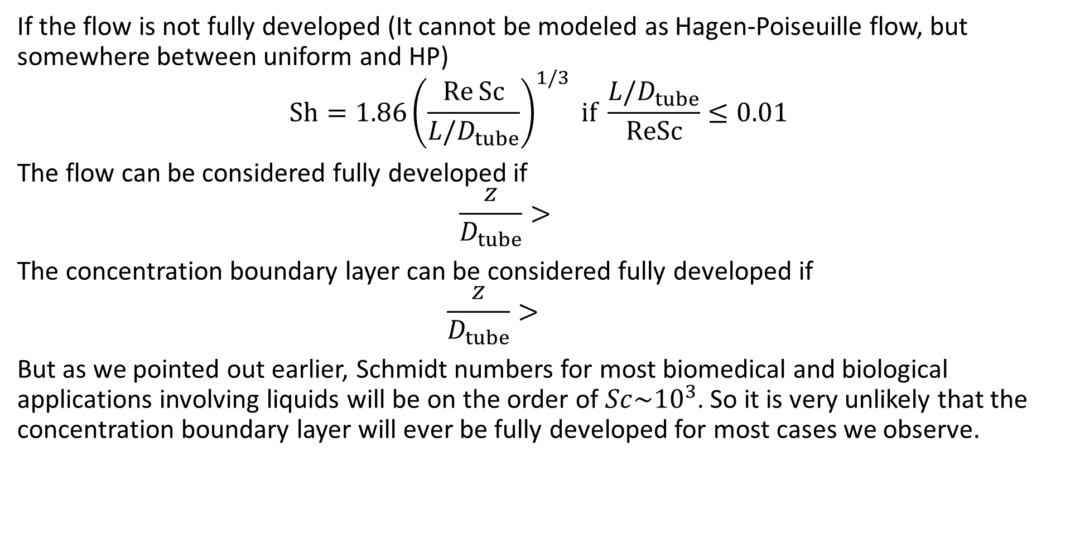
Entry Flow
If the flow is not fully developed (It cannot be modeled as Hagen-Poiseuille flow, but somewhere between uniform and HP)
$$\text{Sh}=1.86{\left(\frac{\text{Re} \text{Sc}}{L/D_{tube}}\right)}^{1/3} \text{if} \frac{L/D_{tube}}{\text{ReSc}}≤0.01$$
The flow can be considered fully developed if
$$\frac{z}{D_{tube}}>$$
The concentration boundary layer can be considered fully developed if
$$\frac{z}{D_{tube}}>$$
But as we pointed out earlier, Schmidt numbers for most biomedical and biological applications involving liquids will be on the order of $Sc\sim {10}^{3}$. So it is very unlikely that the concentration boundary layer will ever be fully developed for most cases we observe.

Slide 24
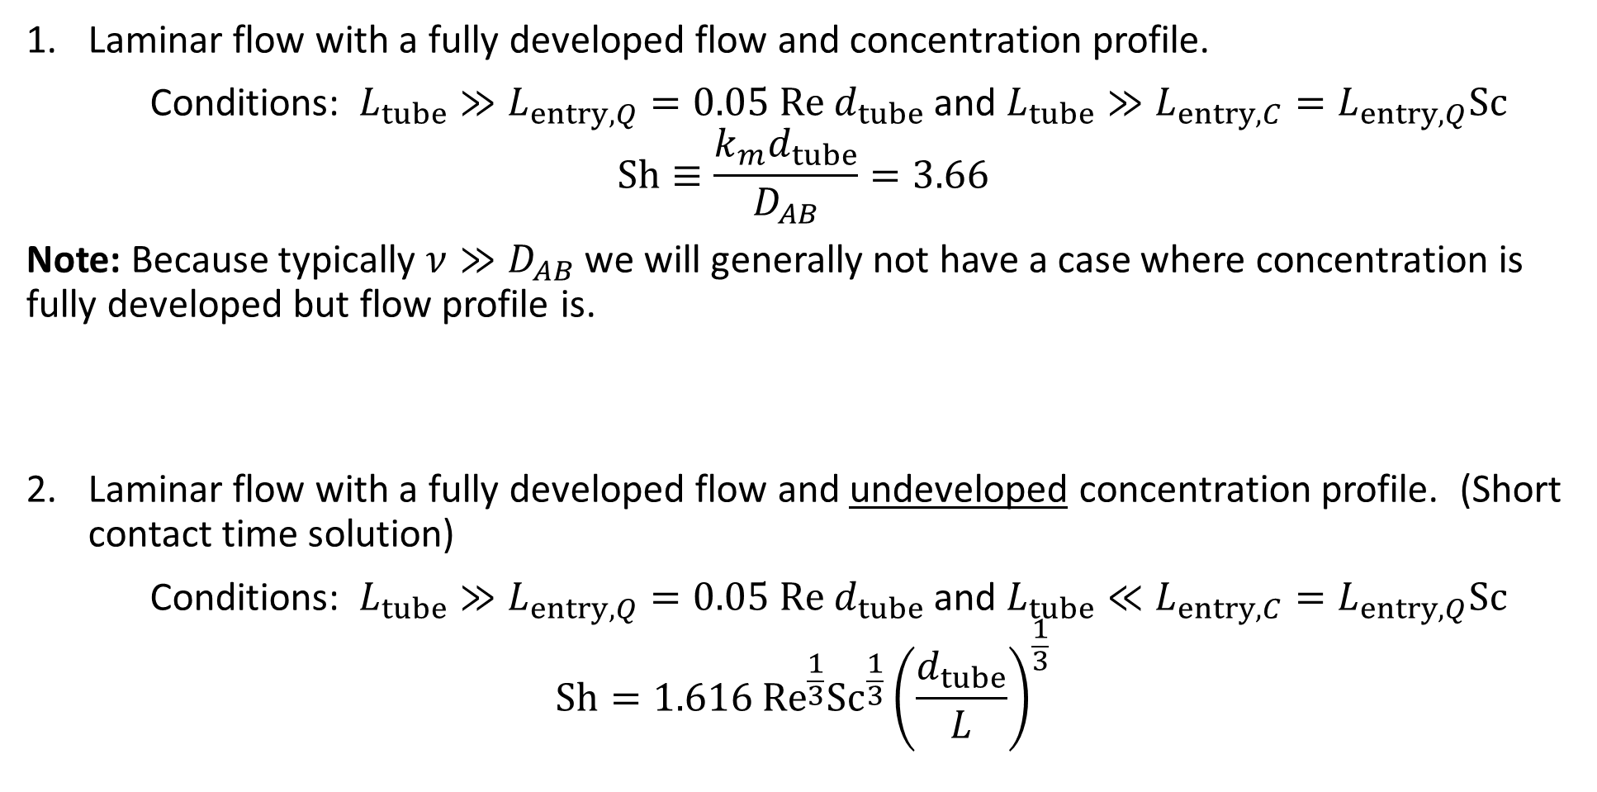
Sherwood Numbers for Circular Pipes
Laminar flow with a fully developed flow and concentration profile.
Conditions: $L_{tube}≫L_{entry, Q}=0.05 \text{Re} d_{tube}$ and $L_{tube}≫L_{entry, C}=L_{entry, Q}\text{Sc}$
$$Sh≡\frac{k_{m}d_{tube}}{D_{AB}}=3.66$$
Note: Because typically $ν≫D_{AB}$ we will generally not have a case where concentration is fully developed but flow profile is.
Laminar flow with a fully developed flow and undeveloped concentration profile. (Short contact time solution)
Conditions: $L_{tube}≫L_{entry, Q}=0.05 \text{Re} d_{tube}$ and $L_{tube}≪L_{entry, C}=L_{entry, Q}\text{Sc}$
$$\text{S}h=1.616 {\text{Re}}^{\frac{1}{3}}{\text{Sc}}^{\frac{1}{3}}{\left(\frac{d_{tube}}{L}\right)}^{\frac{1}{3}}$$

Slide 25
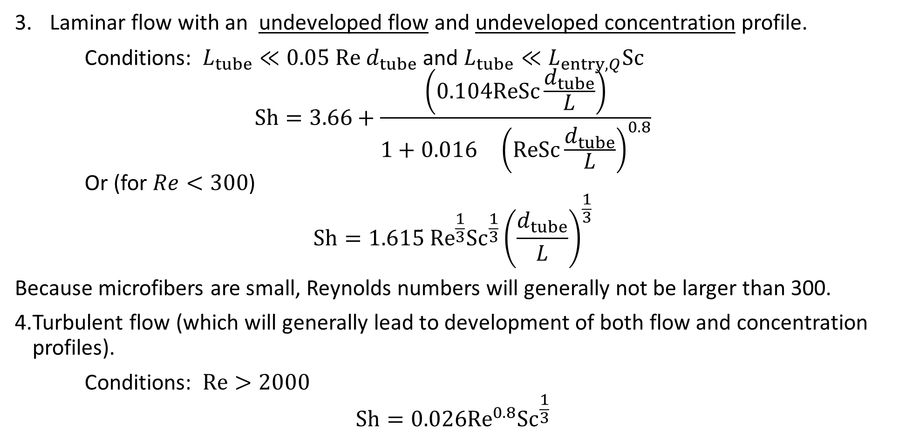
Sherwood Numbers for Circular Pipes
Laminar flow with an undeveloped flow and undeveloped concentration profile.
Conditions: $L_{tube}≪0.05 \text{Re} d_{tube}$ and $L_{tube}≪L_{entry, Q}\text{Sc}$
$$\text{S}h=3.66+\frac{\left(0.104\text{ReSc}\frac{d_{tube}}{L}\right)}{1+0.016 {\left(\text{ReSc}\frac{d_{tube}}{L}\right)}^{0.8}}$$
Or (for $Re<300$)
$$\text{S}h=1.615 {\text{Re}}^{\frac{1}{3}}{\text{Sc}}^{\frac{1}{3}}{\left(\frac{d_{tube}}{L}\right)}^{\frac{1}{3}}$$
Because microfibers are small, Reynolds numbers will generally not be larger than 300.
Turbulent flow (which will generally lead to development of both flow and concentration profiles).
Conditions: $\text{Re}>2000$
$$\text{Sh}=0.026{\text{Re}}^{0.8}{\text{Sc}}^{\frac{1}{3}}$$

Slide 26
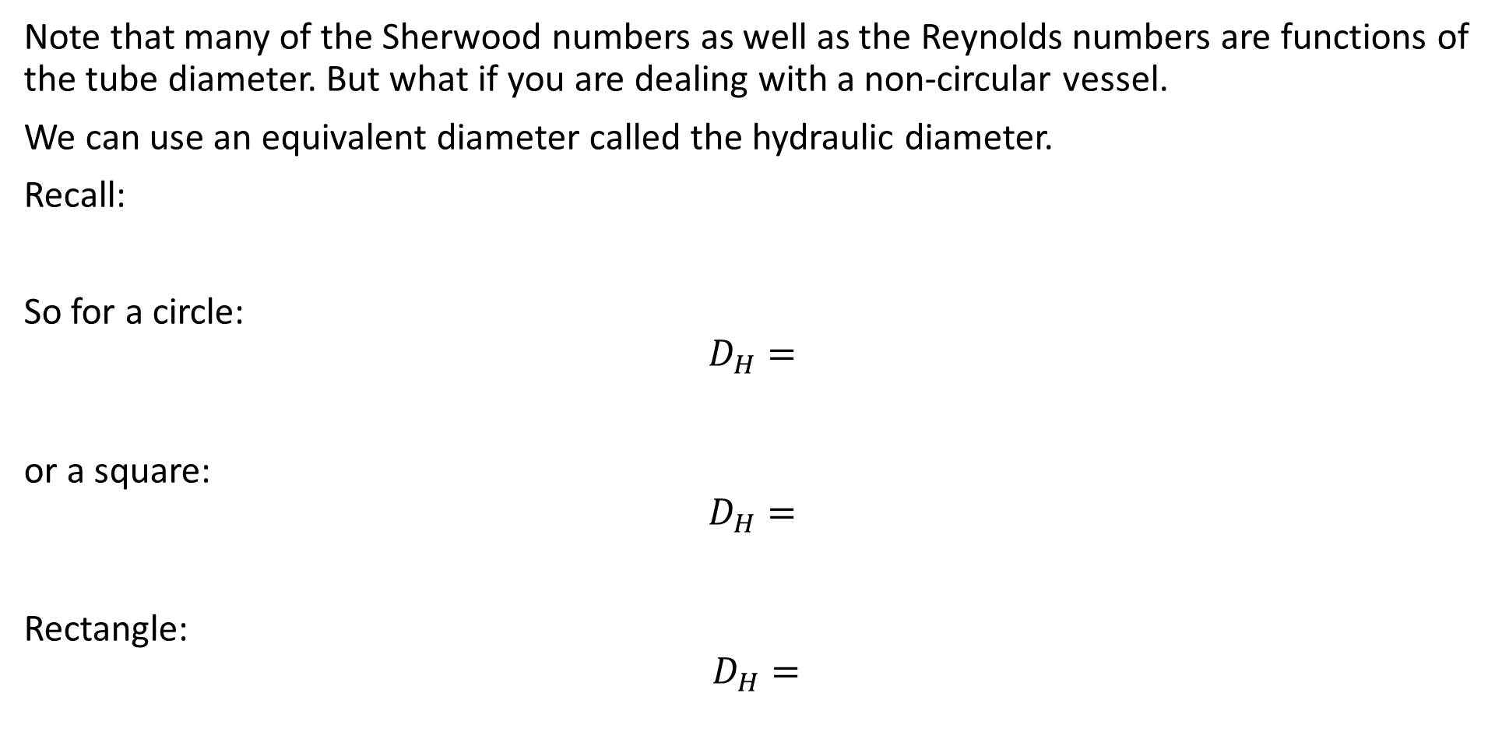
Non-circular tubes
Note that many of the Sherwood numbers as well as the Reynolds numbers are functions of the tube diameter. But what if you are dealing with a non-circular vessel.
We can use an equivalent diameter called the hydraulic diameter.
Recall:
So for a circle:
$$D_{H}=$$
or a square:
$$D_{H}=$$
Rectangle:
$$D_{H}=$$

